Slide 1
Engineering Design DSN2096
By:
Akshay Jadhav

Slide 2
Syllabus
Introduction to Engineering design process: Design History; Dieter Rams Principles of Good Design; Overview of Engineering Design Process: Problem Formulation, Concept generation, Project Planning and Design Making; Human Centred Design (HCD);
Design Thinking for Innovation: Design Thinking as Mindset, Process and Toolbox., Enhancing Design Thinking Through, Empathy, Interviewing, Questioning & Brainstorming, Tools for Design Thinking: Mind Mapping, Innovation Flowchart – Question ladder – SCAMPER (for products) Journey Mapping, Task analysis grid (for services)
Engineering Design Approaches: Professional and societal Context of Design; Different types of design – Conceptual, Embodiment designs and Detailed designs – Identification and Specifications, Standards and codes, Design Features – Design for Aesthetics, Production, Standards, Minimum risk, Ease of maintenance, Quality, Minimum cost and Optimum Design, Service Design - People - Asserts - policies - culture. Iterative process - Exploration - Creation - Reflection - Implementation.

Slide 3
Syllabus
Usability & Reliability: Usability – User requirement; User experience; Usability testing; Customer Co-creation; Reliability & Safety: Human and equipment, safety, Risk analysis, and security, System reliability; Use of e-engineering: Modelling, Simulation and Verification.
Prototyping and Visualization: Design Cycle Model, Metaphor method: Theory and methodology of concept generation, Blend method & Thematic Method. Conceptual Design & Design capability and sociality. Prototyping & Visualization Design Tools – E-tools
Sustainable Design: Concepts of sustainable development, Sustainable design principles - Design for Environment; Life Cycle Assessment; Models of sustainable design- Biomimicry, Eco Design, Recycling; Social Innovation
Communication: Articulating design ideas: Storytelling; Sketching & Dynamic Diagrams; K Scripts

Slide 4
Books and resources
TEXT BOOKS:
Huge Jack, “Engineering Design, Planning, and Management” Academic Press, 2013.
Gerhard Pahl, Wolfgang Beitz “Engineering Design: A Systematic Approach” 2014.

Slide 5
Unit6: Sustainable Design

Slide 6
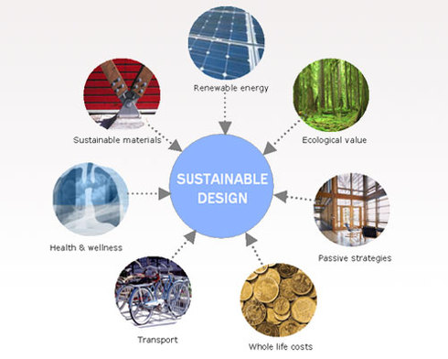
Sustainable Design
Sustainable design seeks to reduce negative impacts on the environment.
Sustainable design acts as a philosophy that is applied by different companies, governmental entities, and non-governmental organizations to achieve a better future for the human race through the wise and low-volume consumption of Earth’s resources.

Slide 7
Concept of Sustainable Development
The concept of sustainable development aims to encourage the use of products and services in a manner that reduces the impact on the environment and optimizes the resources in order to satisfy human needs. To understand why sustainable development is the need of the hour, take a look at the following key pointers that elucidate upon its importance:
Development of non-polluting renewable energy systems
Population stabilization
Integrated land-use planning
Healthy cropland and grassland
Woodland and re-vegetation of marginal lands
Conservation of biological diversity
Control of pollution in water and of the air
Recycling of waste and residues
Ecologically compatible human settlements
Environmental education and awareness at all levels

Slide 8
Principles of Sustainable Design
Form:
Visual shape of the product
The design should save energy consumption, packaging and transporting cost
Function & Usability:
It helps consumers use the product in less time with less energy
Less waste and throwaways
Cost-Effective Solution:
Reducing the cost of current sustainable products
Renewable Energy:
Not carbon energy, maybe solar or wind energy
Durable Design Solutions:
Should reach zero waste
Decrease the dependence on Earth’s resource
Design for Reuse and Recycling:
Afterlife of the product
Bio mimicry:
redesigning industrial systems on biological lines

Slide 9
Design for Environment
Design for environment (DfE) attempts to reduce the impact of product design upon the environment of a product or service. It takes into account the whole life cycle - going beyond just the use of recycled materials or proper packaging or disposal.
The DfE approach includes five aspects that follows the life-cycle of a product, and enables companies to be more environmentally friendly in their work.
These five aspects are -
(1) Materials, and extraction;
(2) Production;
(3) Transport, distribution and packaging;
(4) Use; and
(5) End of life, Design For Disassembly and Design for Recycling.

Slide 10
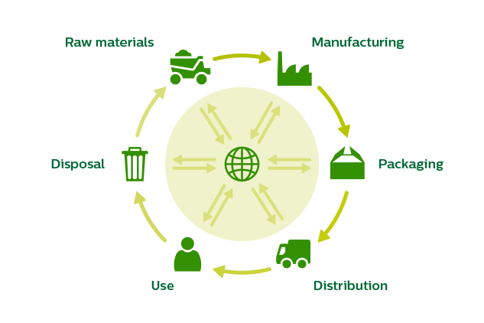
Life Cycle Assessment (LCA)

Slide 11
LCA
Life-cycle assessment (LCA) is a technique to assess environmental impacts associated with all the stages of a product's life from raw material extraction through materials processing, manufacture, distribution, use, repair and maintenance, and disposal or recycling.
The 4 steps of LCA methodology
Goal and scope:
ensures the LCA is performed consistently.
2. Inventory analysis:
look at all the environmental inputs and outputs associated with a product or service
3. Impact assessment:
environmental impacts, impact on human health
4. Interpretation:
check that your conclusions are well-substantiated

Slide 12
Models of sustainable design
Biomimicry,
Eco Design,
Recycling;
Social Innovation.

Slide 13
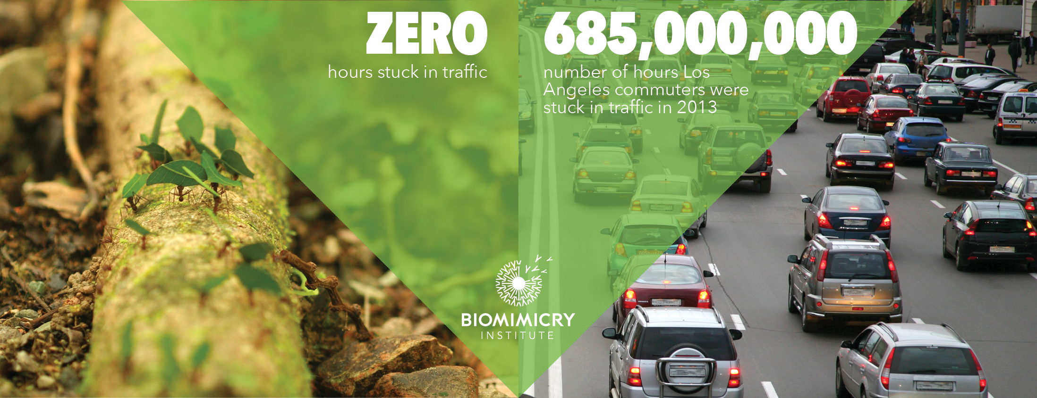
Biomimicry
Biomimicry is an approach to innovation that seeks sustainable solutions to human challenges by emulating nature’s time-tested patterns and strategies.
Biomimicry is derived from the Greek words “bios” meaning life and “mimesis” meaning imitate.

Slide 14
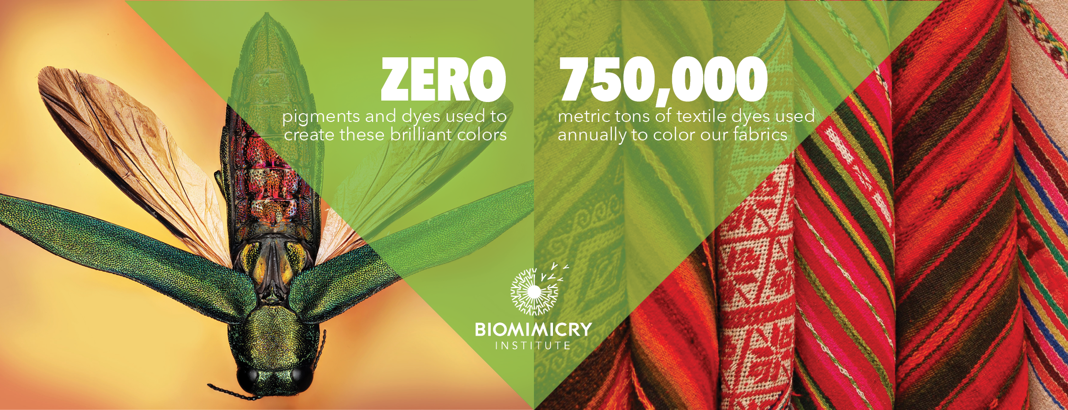
Biomimicry
Biomimicry is an approach to innovation that seeks sustainable solutions to human challenges by emulating nature’s time-tested patterns and strategies.
Biomimicry can be considered a rising movement that stresses the derivation of “innovative and environmentally sound design from organic systems.

Slide 15
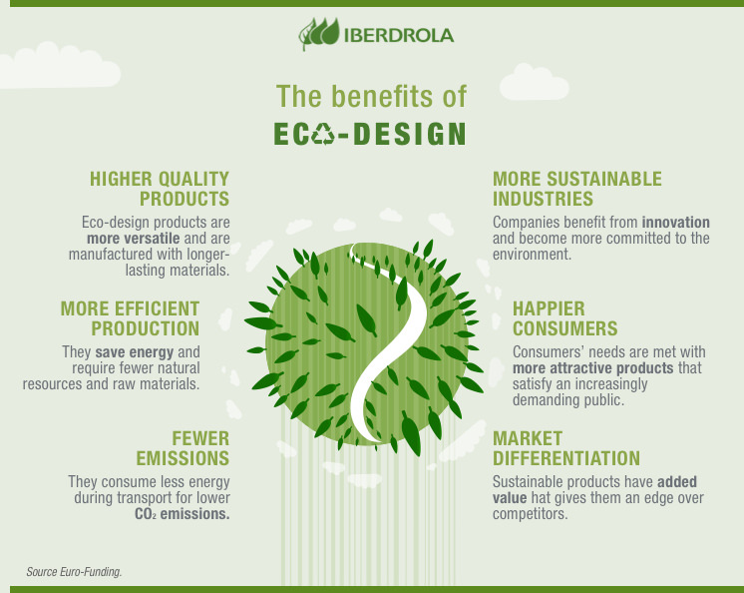
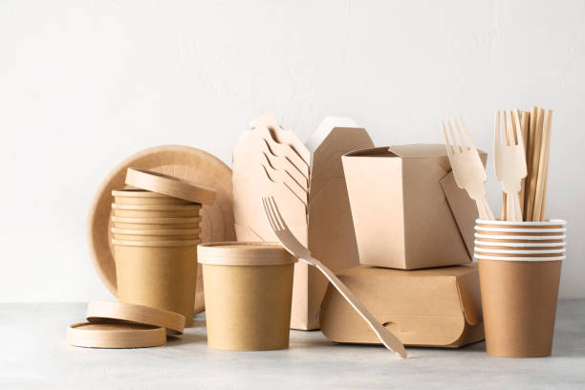
Eco Design
Eco design is part of a global approach called “multi-step” and “multi-criteria”. This approach supports a product’s entire lifecycle in a circular economy perspective by saving and recycling at maximum natural resources.
Example:

Slide 16
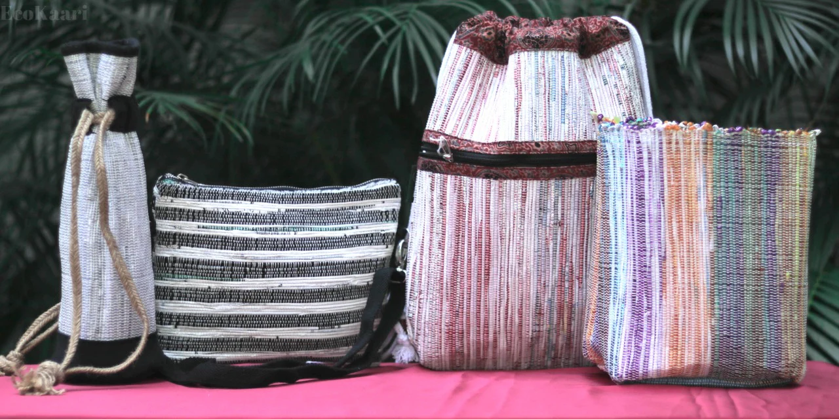
Recycling
Recycling is the process of converting waste materials into new materials and objects. The recovery of energy from waste materials is often included in this concept. The recyclability of a material depends on its ability to reacquire the properties it had in its original state.
Examples:
Glass recycling, paper recycling, metal recycling, plastic and textile recycling and finally electronic recycling.
A Social enterprise Indian Startup
Ecokaari - Creating Sustainable Fashion using Plastic Wrappers
EcoKaari’s upcycling process is fascinating as they use a traditional charkha (spindle) and handloom to weave fabric from waste plastic.

Slide 17
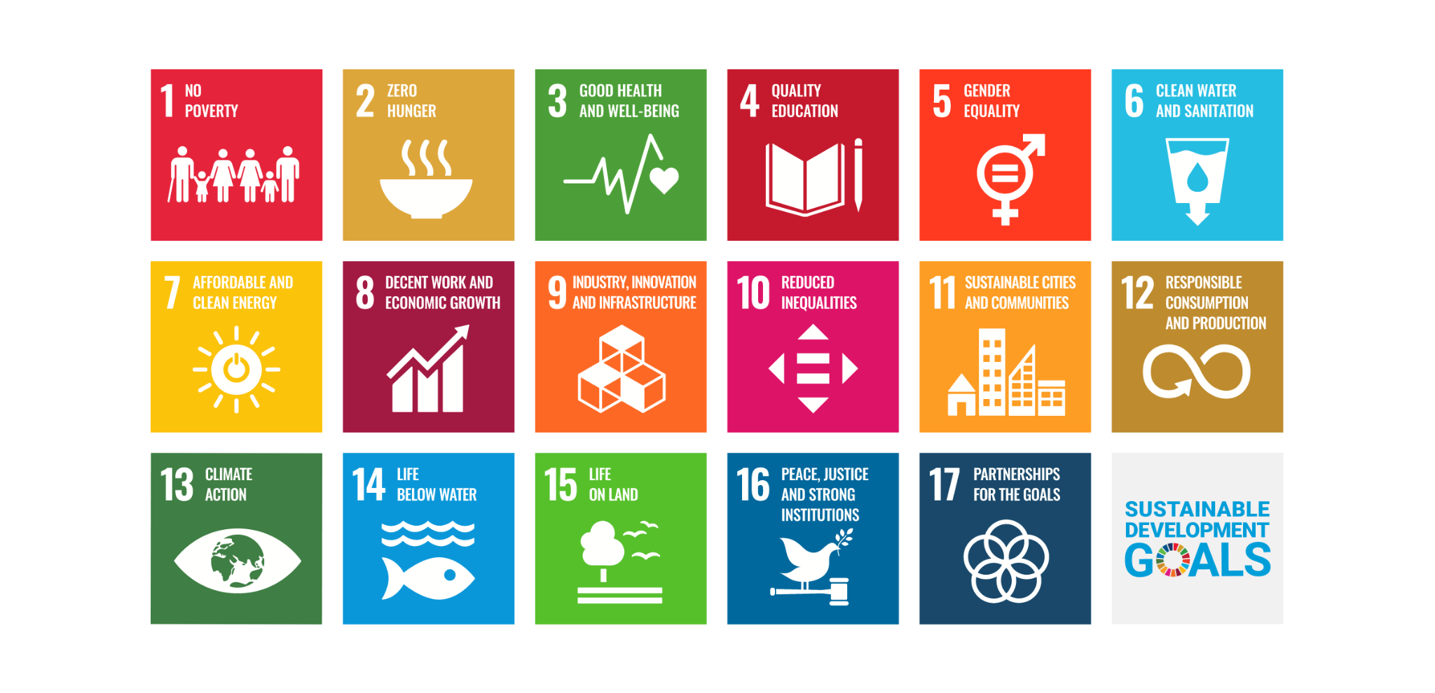
Social Innovation

Slide 18
Thanks!

